Slide 1

Analysis of predictors of Low Density Lipoprotein Cholesterol (LDL) Among Postmenopausal Women in 1998
Barsha Thakur Jing Xie
Bekana Tadese Yuan Li
Group 8 |
Applied Linear Regression PH 1820
April 28, 2020

Slide 2
Background
Dataset
The Heart and Estrogen/progestin Replacement Study (HERS) clinical trial of hormone therapy in postmenopausal women (Hulley et al, JAMA 1998).
Research Question
What are the predictors of LDL cholesterol levels among postmenopausal women in HERS clinical trial?
Outcome Variable Low Density Lipoprotein (LDL)
Potential Factors
High density lipoprotein cholesterol (HDL)
Glucose level
Smoking (Yes=1 No=0 )
Race-ethnicity (1 Caucasian; 2 African-American; 3 others)
Diastolic blood pressure (DBP)
Systolic blood pressure (SBP)
Age in years
triglycerides (TG)
Body mass Index (BMI)

Slide 3
Methods
Data cleaning-missing values
Visually analyze raw dataset
Randomly split dataset
training set --- 66%
testing set --- 34%
Visually analyze data
Boxplot, Histogram, qqplot, scatter matrix, correlation matrix
Conduct Preliminary model- first order full model
Preliminary model Diagnostics
Linearity --- scatterplot of Y vs. X’s/ Y vs. residuals
Homoscedasticity of errors --- scatterplot of residuals vs. X’s
Normality of errors --- QQ plot of residuals / Shapiro-Wilk Test
Independence --- assess collinearity

Slide 4
Methods
Remedy of preliminary model—second model
Transformation of Y --- Box cox transform
Transformation of X ---trial
Assess second model (same as preliminary model diagnostics)
Test interaction between predictors
Model selection—reduced model
Mallow’s Cp selection method
Reduced model Diagnostics (same as preliminary model diagnostics)
Assess influential points
Cook’s-D, leverage, DIFFTS and outliers
Validation in testing set
Notes:
To remedy preliminary model, we tried to transform Y and some X variables using Box-Cox,which yield to the second model. We then tested interaction of some predictors based on the diagnosis result of second model.
Next, we did model selection using all the first order predictors and interaction terms by Mallow’s Cp criterion. Last, we assessed the influential points with the selected top 2 best models and validated them in testing data set.

Slide 5
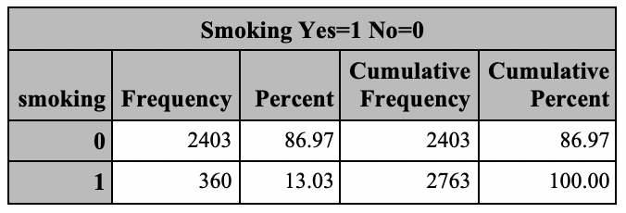
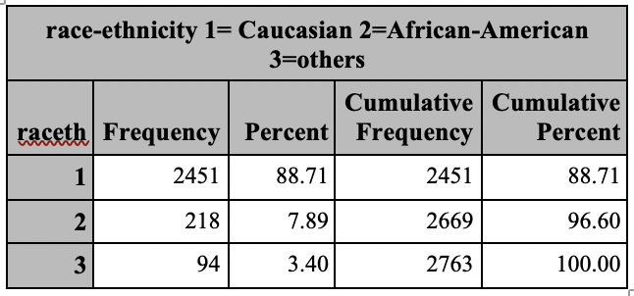
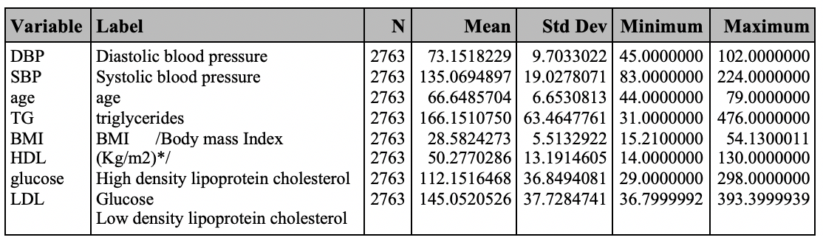
Result Data Cleaning
Categorical variables
no missing values
Continuous variables
missing values ---> mean
Notes:
Results: First, We look at the raw data. We found there is no missing values in categorical variables; However, some missing values exist in continuous variables
Since the number of missing value is less than 20% of entire dataset, we replace the missing value with mean value of each variable.
The tables in this slide is the data distribution after data cleaning.

Slide 6
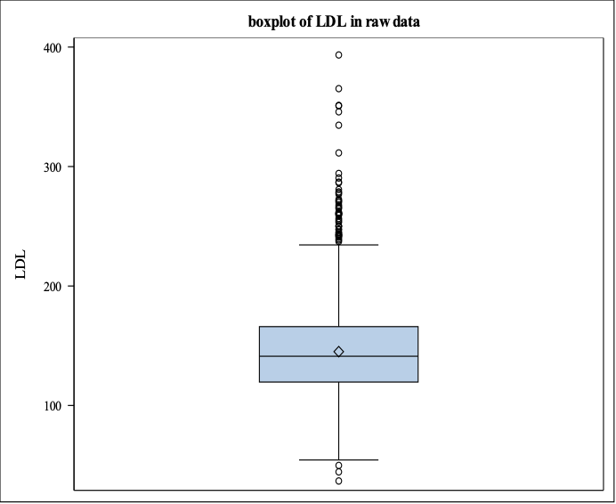
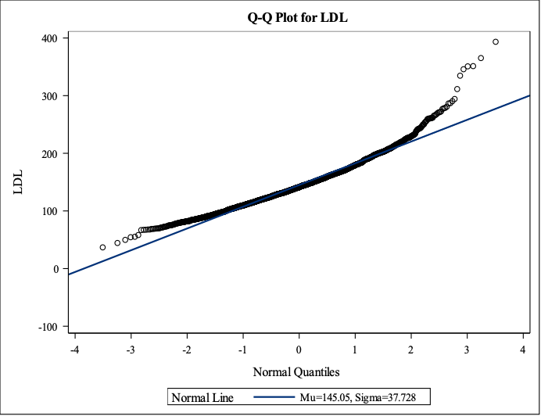
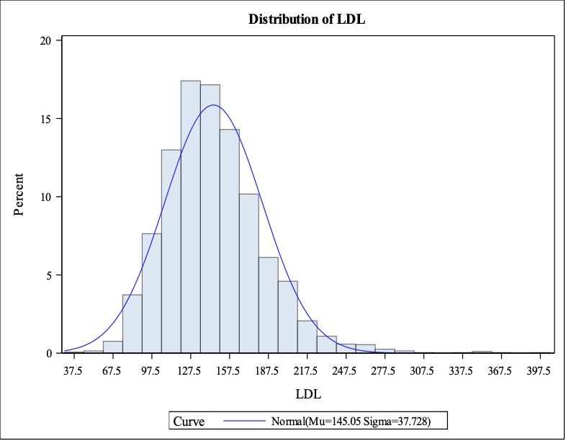
LDL
Result Entire Data Distribution
NON-normality
Notes:
Having fixed the missing values, We checked the data distribution of entire dataset. Here, just show the result of LDL distribution, which is non-normal with right-sided tail.

Slide 7
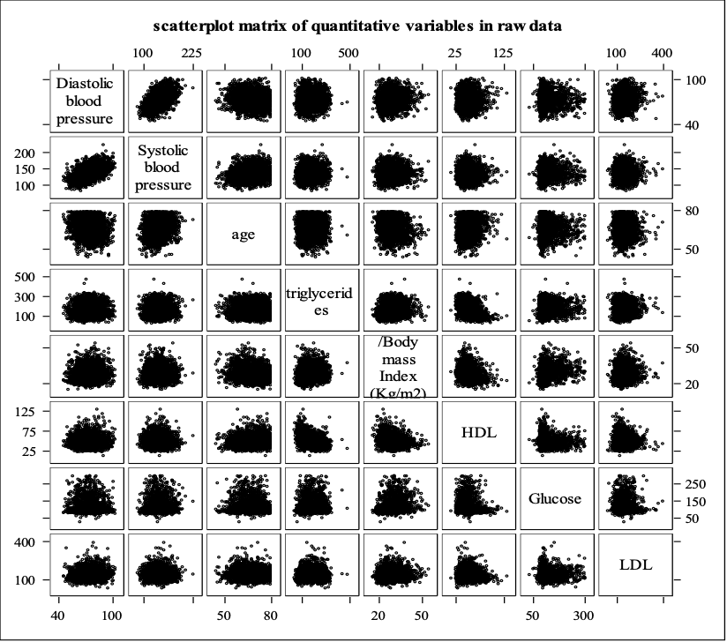
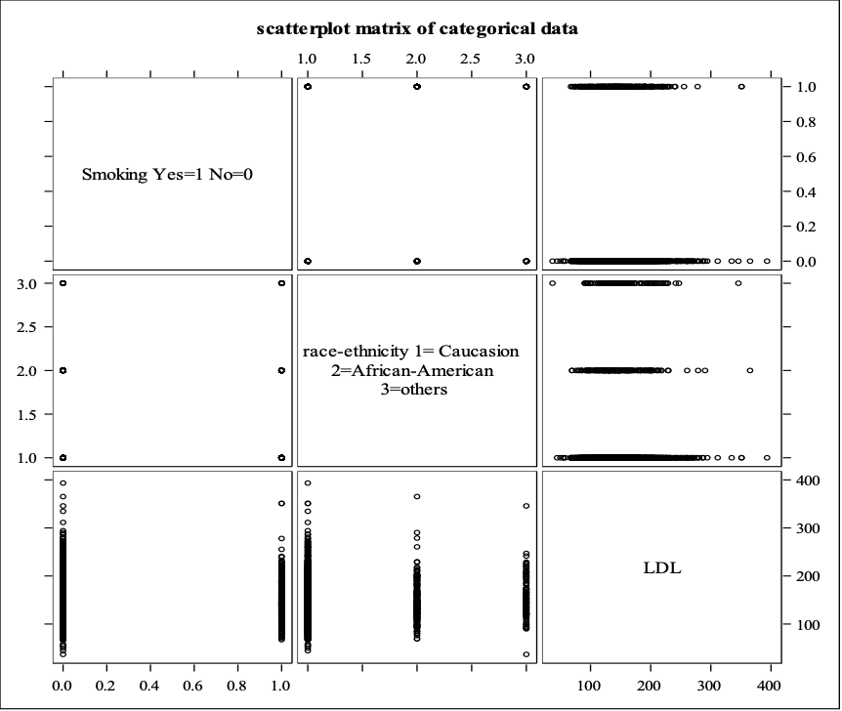
Correlation
Result Entire Data Distribution
Notes:
This is scatter matrix of continuous variables vs. Y and categorical variables vs. Y in raw data,

Slide 8
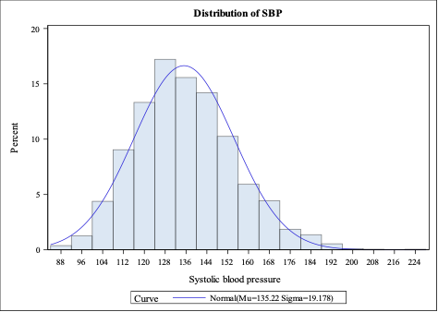
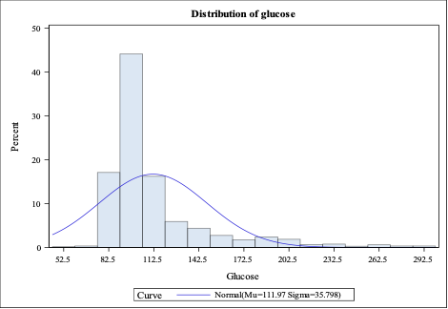
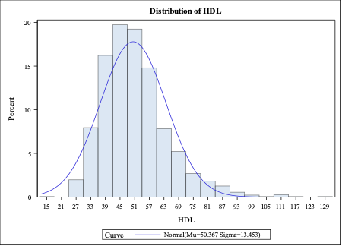
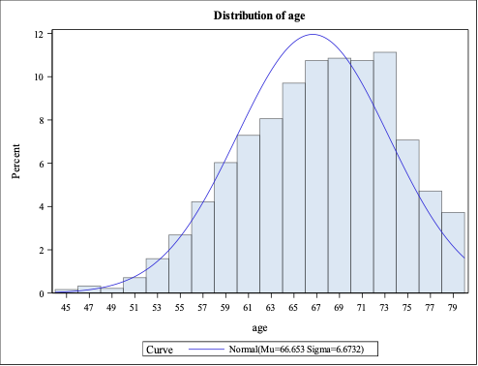
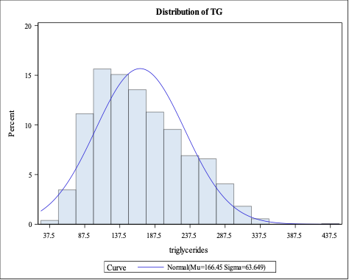
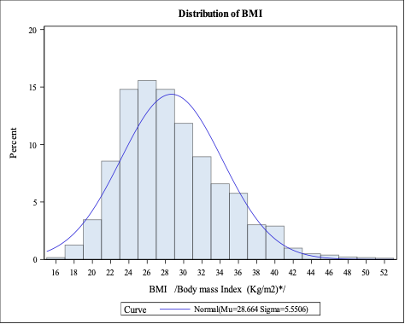
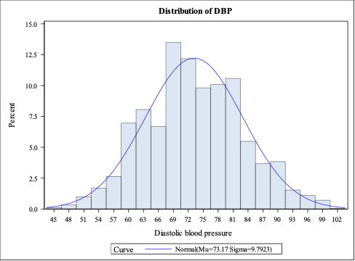
Predictors
Result Training Data Distribution
NON-normality
Notes:
Having a brief view of the raw data, we turn to have a look at the training set after splitting. First, we visually analyzed training set and found all the predictors are non-normal

Slide 9
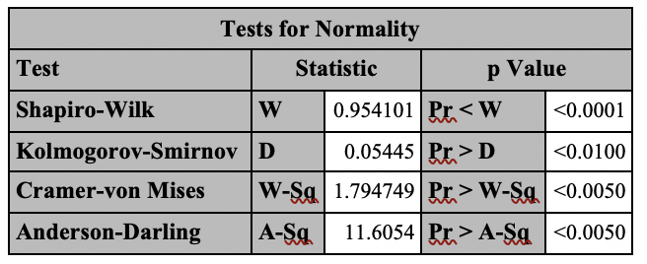
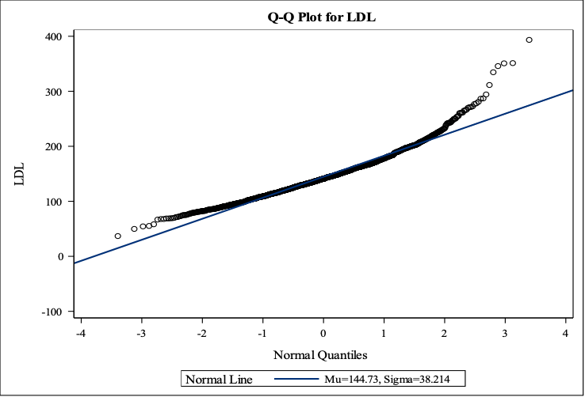
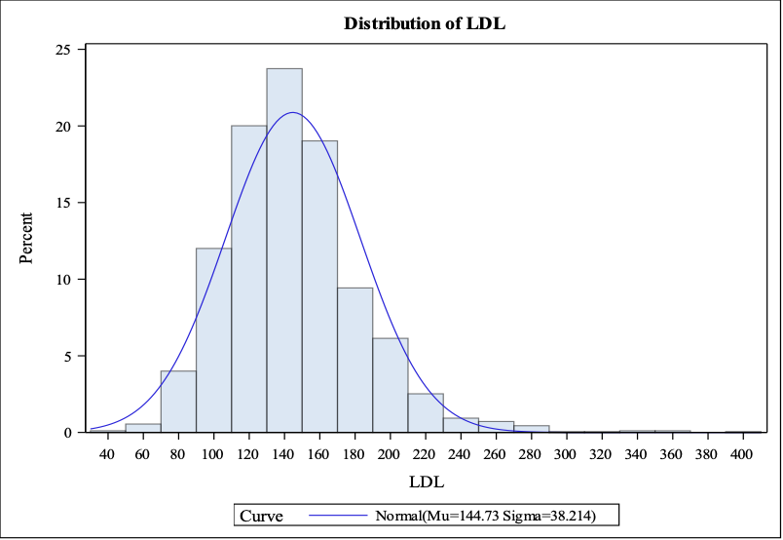
LDL
Result Training Data Distribution
NON-normality
May need to transform for normality
Notes:
LDL in training set is also non-normally distributed with p value less than 0.001 in shapiro-wilk test. These distribution in training set is consistent with the distribution in raw data

Slide 10
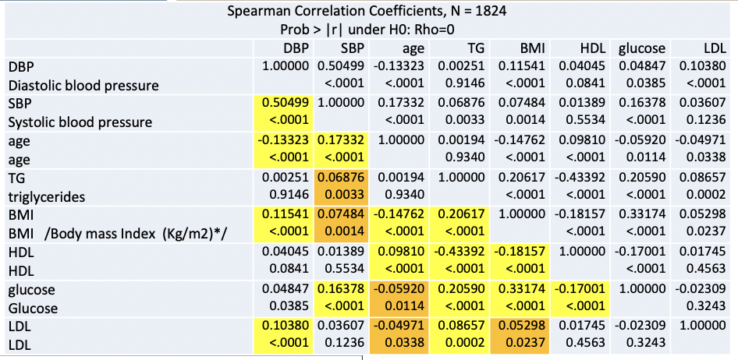
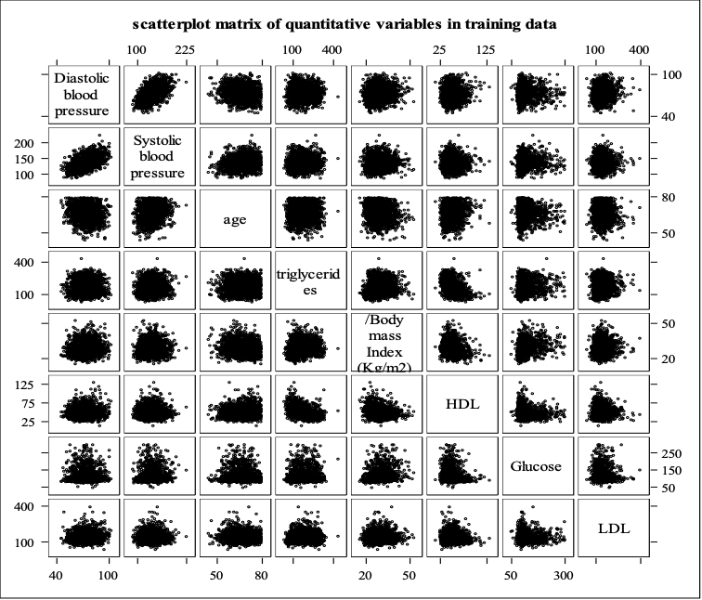
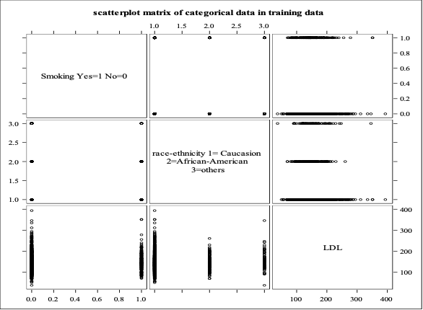
Correlation
Result Training Data Distribution
Notes:
We also looked at the scatter matrix in training set, and the the correlation matrix was highlighted with different colors according to different levels of p value. Yellow shows p value is less than 0.001, and orange shows p value is between 0.05 to 0.001. We found the LDL is correlated with DBP, age, TG and BMI based on the significant level of 0.05. Besides, there are correlations between predictors, but the the correlation coefficients are not large. Thus, there might be no serious multicollinearity, and we will further test it.

Slide 11
Assessing the preliminary model
Result
Parameter Estimates
Variable | Label | DF | Parameter Estimate | Standard Error | t Value | Pr > |t| | Variance Inflation
Intercept | Intercept | 1 | 128.31301 | 14.82933 | 8.65 | <.0001 | 0
DBP | Diastolic blood pressure | 1 | 0.37407 | 0.11234 | 3.33 | 0.0009 | 1.53810
SBP | Systolic blood pressure | 1 | -0.01829 | 0.05739 | -0.32 | 0.7500 | 1.53965
age | age | 1 | -0.19356 | 0.14647 | -1.32 | 0.1865 | 1.21419
TG | triglycerides | 1 | 0.04621 | 0.01539 | 3.00 | 0.0027 | 1.21961
BMI | Body mass Index | 1 | 0.25534 | 0.17326 | 1.47 | 0.1407 | 1.17550
HDL | High density lipoprotein cholesterol | 1 | -0.01032 | 0.07335 | -0.14 | 0.8881 | 1.23763
glucose | Glucose level | 1 | -0.04686 | 0.02633 | -1.78 | 0.0753 | 1.12911
smoking | Smoking Yes=1 No=0 | 1 | 3.32736 | 2.78933 | 1.19 | 0.2331 | 1.07812
caucasian | caucasian 1=caucasian 0=others | 1 | -5.54683 | 4.67428 | -1.19 | 0.2355 | 2.86576
african | african 1=african 0=others | 1 | -4.38264 | 5.54523 | -0.79 | 0.4294 | 2.80730
Analysis of Variance
Source | DF | Sum of Squares | Mean Square | F Value | Pr > F
Model | 10 | 61725 | 6172.50197 | 4.30 | <.0001
Error | 1813 | 2600384 | 1434.29920
Corrected Total | 1823 | 2662109
Root MSE | 37.87214 | R-Square | 0.0232
Dependent Mean | 144.72767 | Adj R-Sq | 0.0178
Coeff Var | 26.16787
Notes:
We fit the preliminary model. The p value is less than 0.0001 and Vifs are not high. We will go ahead to check residuals.

Slide 12
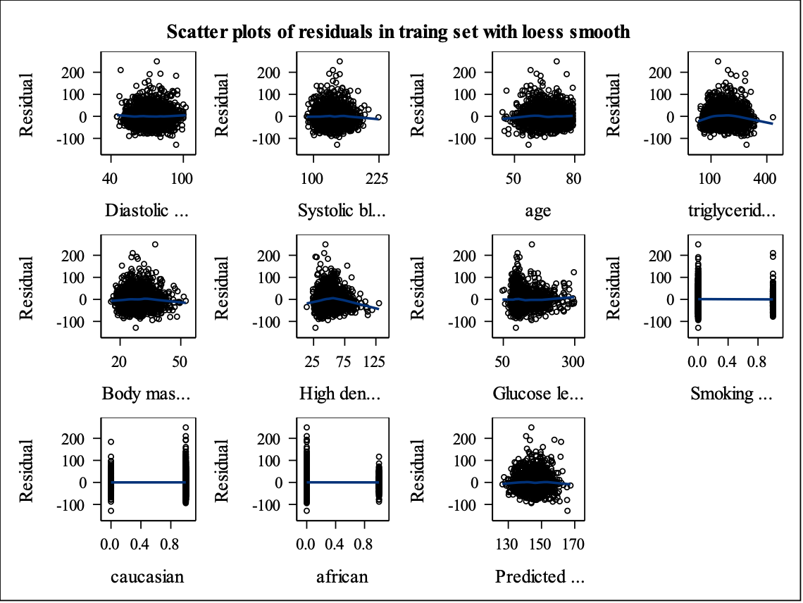

Result_Primary Model Residual Analysis
Check for linearity of residuals
Check for constant variance of residuals
Notes:
This is the scatter plots of residuals.
Linearity looks ok on predictors.
Constancy of variance looks not good, especially on HDL and glucose , we can see the megaphone shape.

Slide 13
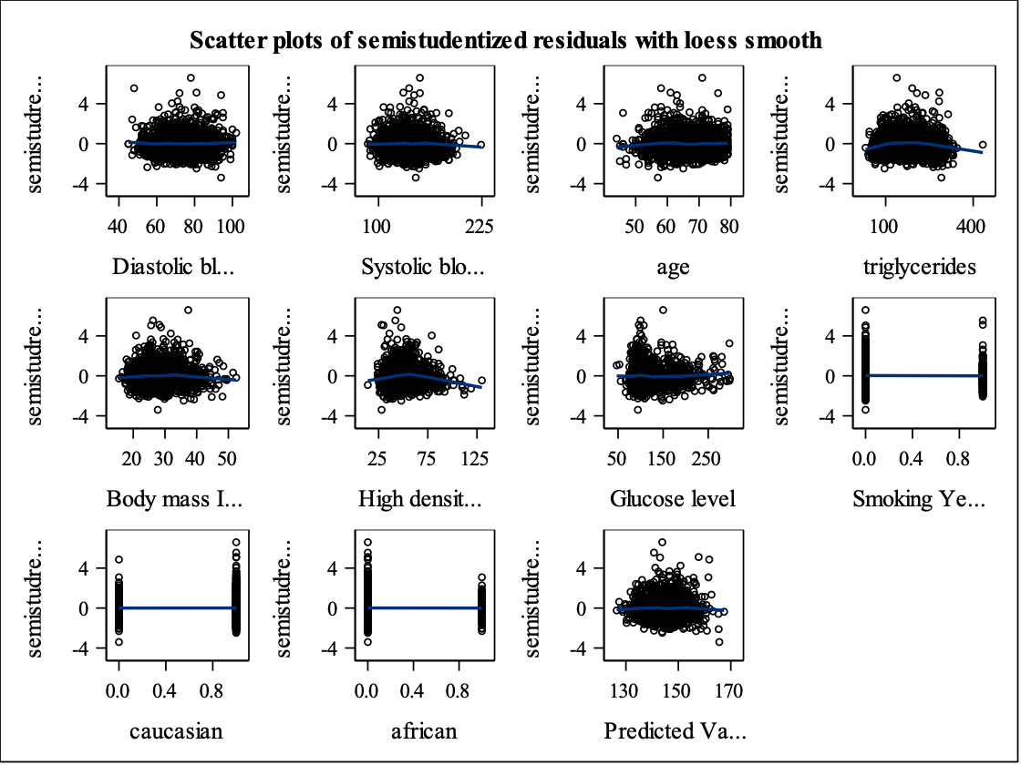
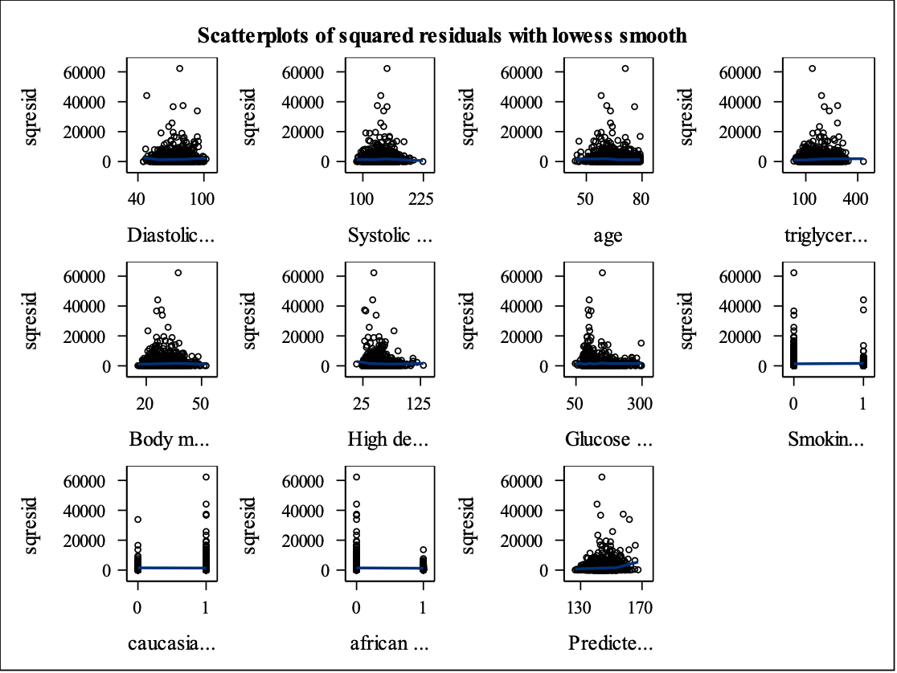
Result_Primary Model Residual Analysis
Check for constant variance of residuals and outliers
Notes:
This is the scatter plots of semistudentized and squared residuals.
Constancy of variance looks not good.
We can find there are several outliers out of band.

Slide 14
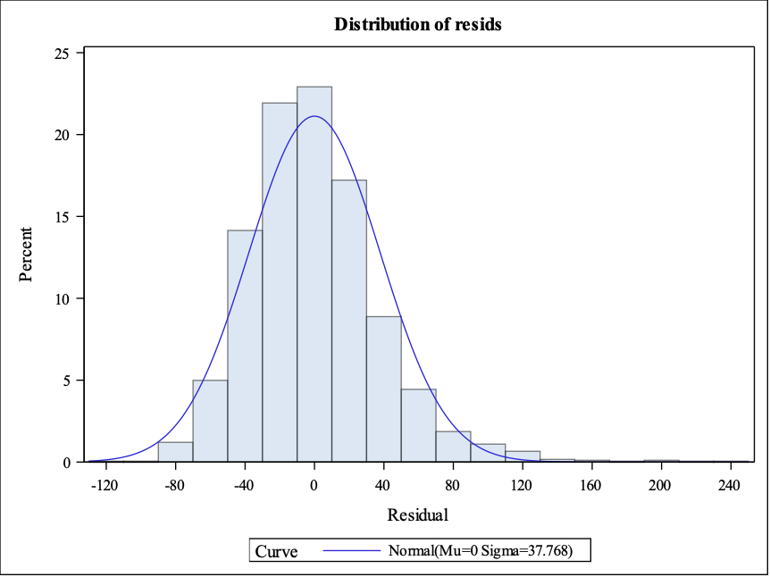
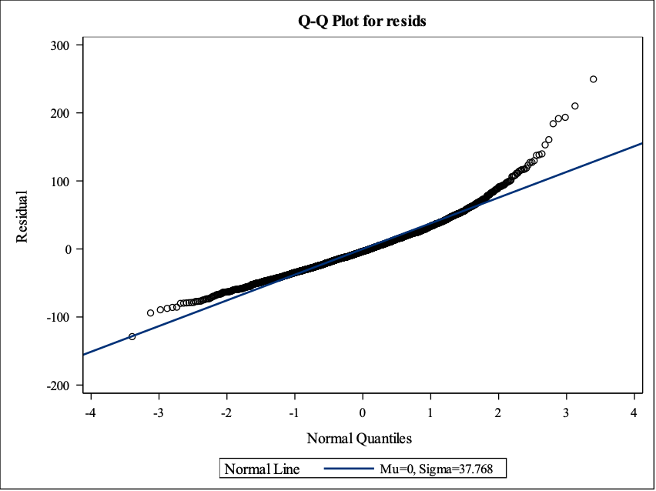
Result_Primary Model Residual Analysis
Check for normality of residuals
Histogram
QQ plot
Shapiro-Wilk Test P< 0.0001
Notes:
The distribution of residuals is not normal, which can be seen from the right skewed histogram, obvious deviation at the two ends of qq plot, and p-value <0.0001 on shapiro-wilk test.

Slide 15
Remediation
Non constant variance
Non normality
Transformation: try log(LDL) recommended by Box Cox
Notes:
Due to the non-constancy and non-normality, we tried to transform LDL to see if the problem can be fixed. Box cox recommended log transformation.

Slide 16
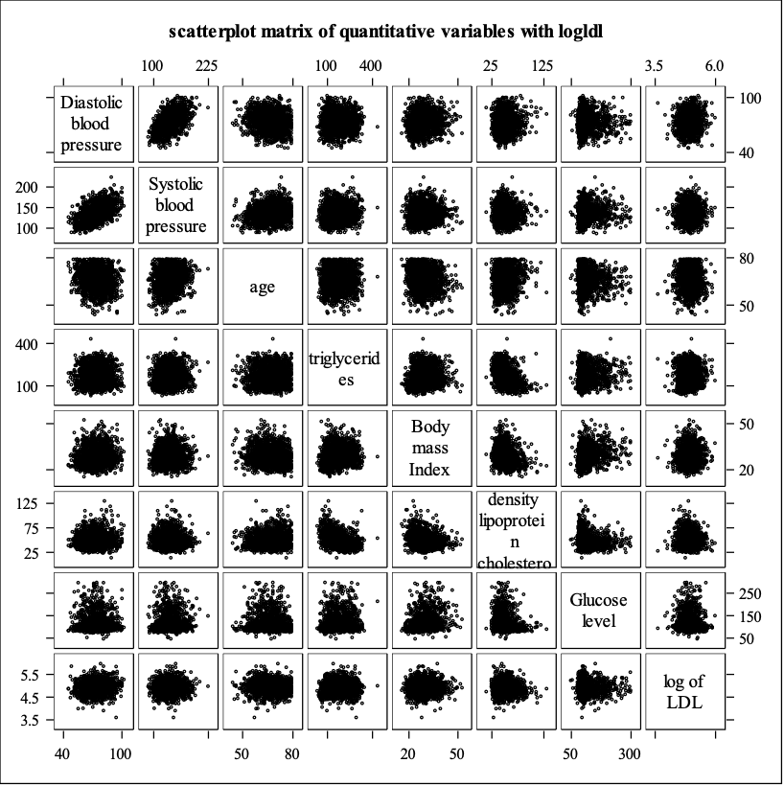
Result_Correlation Transformation on LDL
Pearson Correlation Coefficients, N = 1824 Prob > |r| under H0: Rho=0
 | DBP | SBP | age | TG | BMI | HDL | glucose | logldl
DBP Diastolic blood pressure | 1.00000 | 0.51769 <.0001 | -0.14046 <.0001 | 0.00217 0.9263 | 0.10849 <.0001 | 0.04216 0.0719 | 0.00699 0.7656 | 0.10322 <.0001
SBP Systolic blood pressure | 0.51769 <.0001 | 1.00000 | 0.17292 <.0001 | 0.07386 0.0016 | 0.05824 0.0129 | 0.01192 0.6108 | 0.11475 <.0001 | 0.03488 0.1365
age age | -0.14046 <.0001 | 0.17292 <.0001 | 1.00000 | 0.00247 0.9161 | -0.14765 <.0001 | 0.10322 <.0001 | -0.08044 0.0006 | -0.04304 0.0661
TG triglycerides | 0.00217 0.9263 | 0.07386 0.0016 | 0.00247 0.9161 | 1.00000 | 0.16726 <.0001 | -0.39840 <.0001 | 0.14733 <.0001 | 0.06130 0.0088
BMI Body mass Index | 0.10849 <.0001 | 0.05824 0.0129 | -0.14765 <.0001 | 0.16726 <.0001 | 1.00000 | -0.18404 <.0001 | 0.27690 <.0001 | 0.04480 0.0558
HDL High density lipoprotein cholesterol | 0.04216 0.0719 | 0.01192 0.6108 | 0.10322 <.0001 | -0.39840 <.0001 | -0.18404 <.0001 | 1.00000 | -0.14295 <.0001 | -0.02926 0.2117
glucose Glucose level | 0.00699 0.7656 | 0.11475 <.0001 | -0.08044 0.0006 | 0.14733 <.0001 | 0.27690 <.0001 | -0.14295 <.0001 | 1.00000 | -0.03215 0.1699
logldl log of LDL | 0.10322 <.0001 | 0.03488 0.1365 | -0.04304 0.0661 | 0.06130 0.0088 | 0.04480 0.0558 | -0.02926 0.2117 | -0.03215 0.1699 | 1.00000
Notes:
Scatter plot and correlation matrix show that linear relationship between log ldl and each predictor is not strong, and there is no serious multicollinearity.

Slide 17
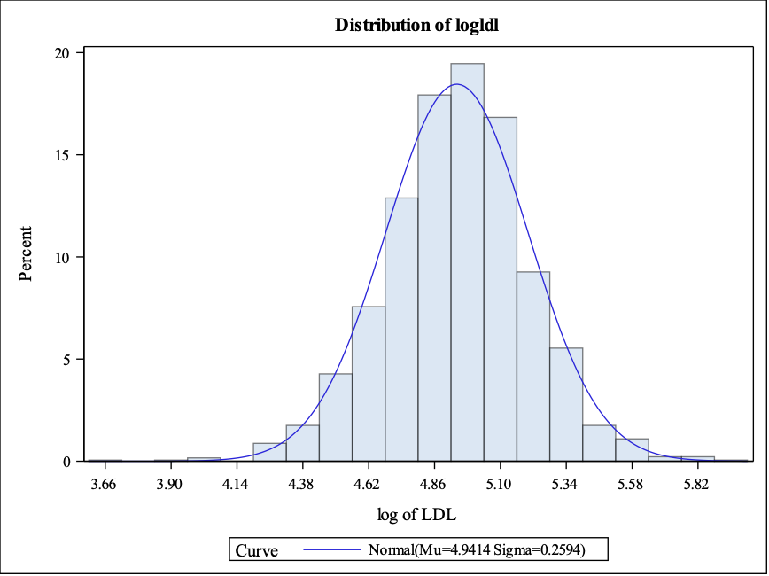
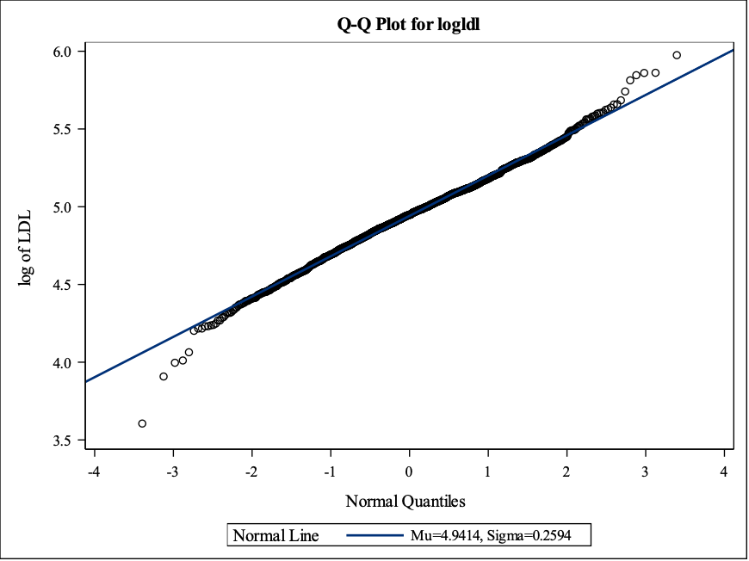
Result Transformation on LDL
Check for normality of log LDL
Histogram
QQ plot
Shapiro-Wilk Test P< 0.0001
Notes:
After log transformation of LDL, we checked the assumptions again.
Normality of log LDL does not meet, and this can be seen from the left skewed distribution on histogram and p-value is less than 0.0001 on shapiro-wilk test, although QQ plot shows the data fits the line much better except some outliers at the two ends.
From the graphs, it seems that the issue of non-normality is because of the presence of outliers or the influential points. We are going to assess these points later.

Slide 18
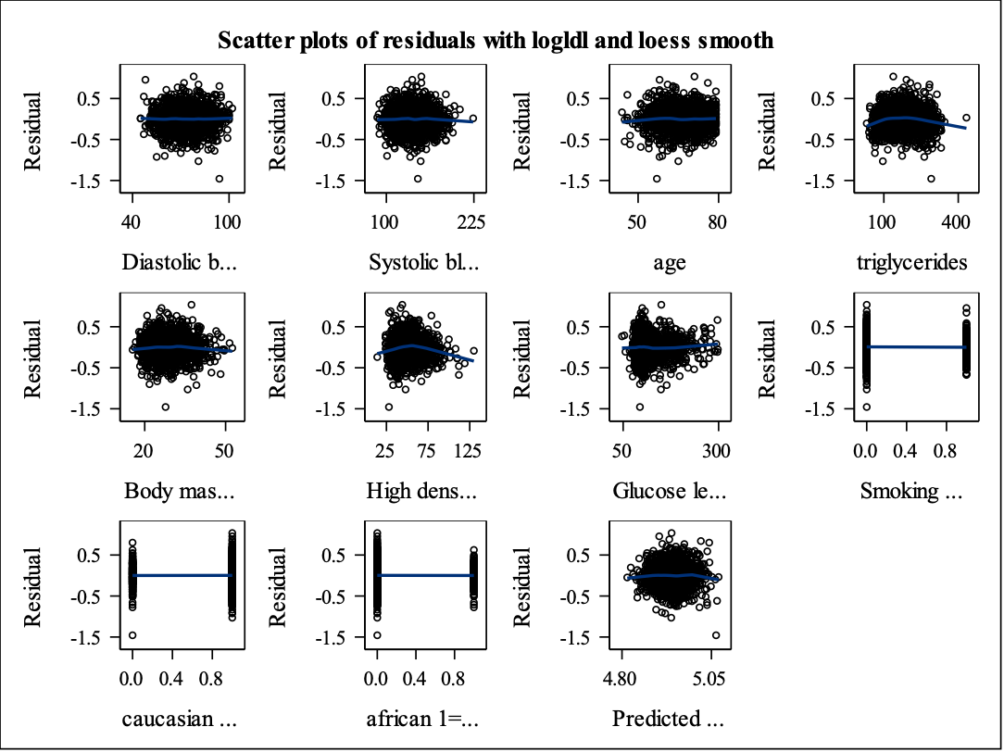
Result_Second Model Residual Analysis
Check for linearity of residuals
Check for constant variance of residuals
Notes:
This is the scatter plots of residuals with log LDL.
Linearity still looks ok.
Constancy of variance looks better except on HDL and Glucose, still having the megaphone shape.

Slide 19
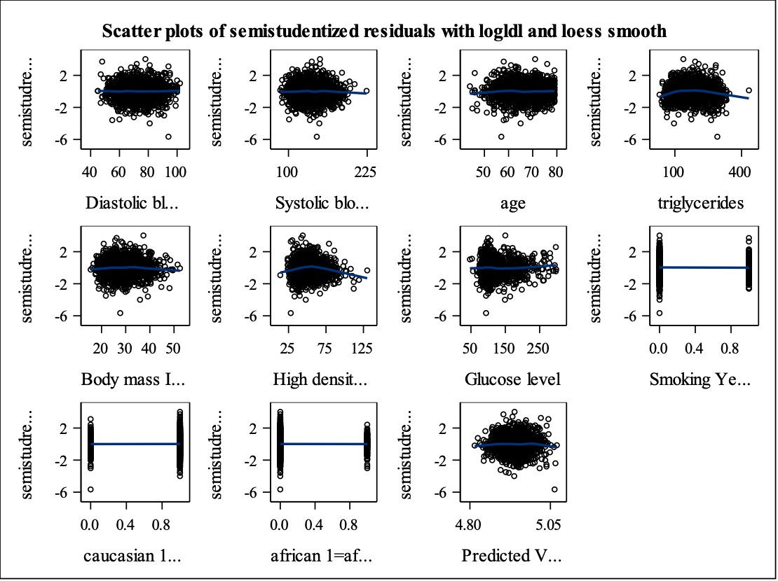
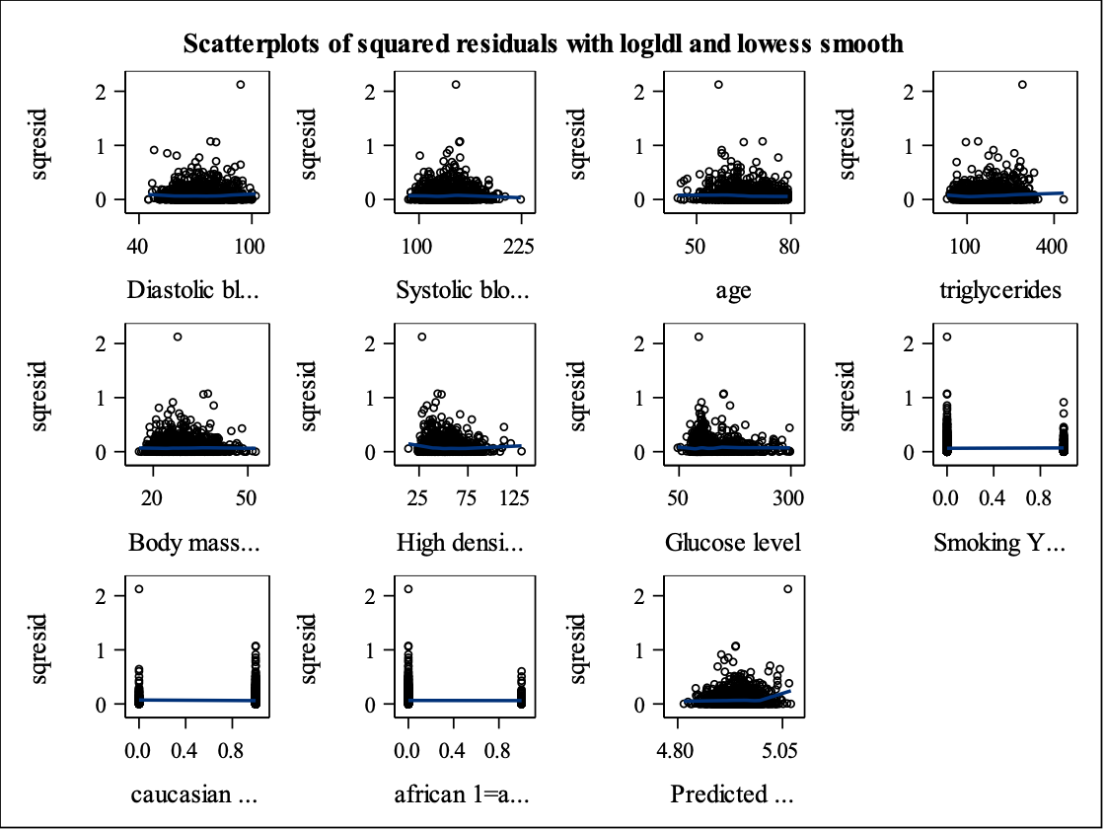

Result_Second Model Residual Analysis
Check for constant variance of residuals and outliers
Notes:
This is the scatter plots of semi-studentized and squared residuals with log LDL.
Constancy of variance looks better.
We can see, there is an outlier.

Slide 20
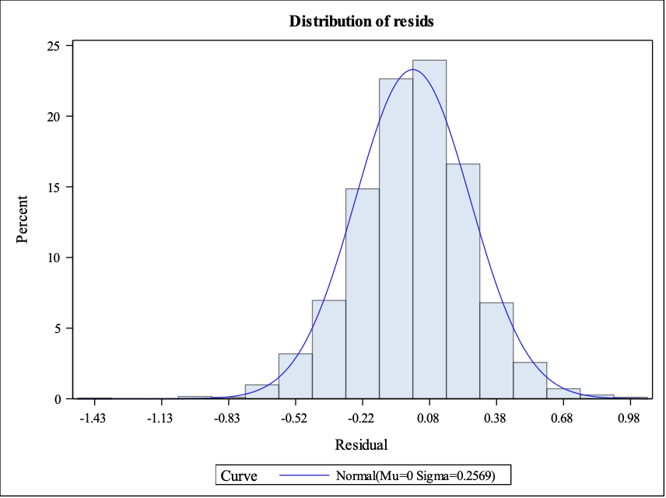
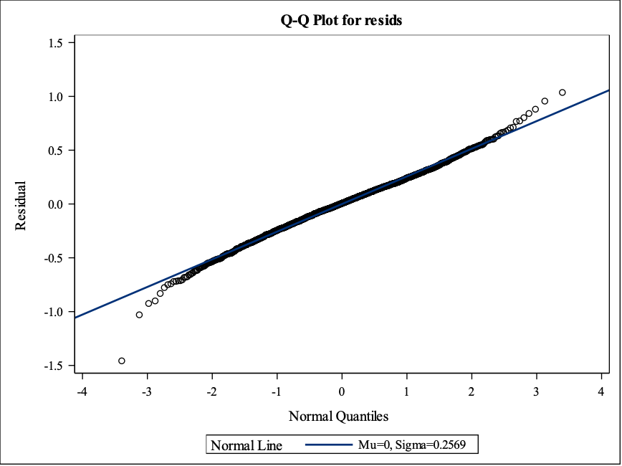
Result_Second Model Residual Analysis
Check for normality of residuals
Histogram
QQ plot
Shapiro-Wilk Test P< 0.0001
Notes:
Check the normality of residuals with log LDL:
A little bit left skewed on histogram,
QQ plot shows the data fits the line well except a little deviation at the two ends, but p-value <0.0001 on shapiro-wilk test.
We can try the same transformation on predictor HDL and glucose to see if it can fix the violation.

Slide 21
Assessing the second model with log LDL
Result Transformation on LDL
Parameter Estimates
Variable | Label | DF | Parameter Estimate | Standard Error | t Value | Pr > |t| | Variance Inflation
Intercept | Intercept | 1 | 4.79922 | 0.10085 | 47.59 | <.0001 | 0
DBP | Diastolic blood pressure | 1 | 0.00264 | 0.00076400 | 3.45 | 0.0006 | 1.53810
SBP | Systolic blood pressure | 1 | -0.00022338 | 0.00039030 | -0.57 | 0.5672 | 1.53965
age | age | 1 | -0.00067061 | 0.00099609 | -0.67 | 0.5009 | 1.21419
TG | triglycerides | 1 | 0.00024957 | 0.00010467 | 2.38 | 0.0172 | 1.21961
BMI | Body mass Index | 1 | 0.00187 | 0.00118 | 1.58 | 0.1135 | 1.17550
HDL | High density lipoprotein cholesterol | 1 | -0.00009730 | 0.00049884 | -0.20 | 0.8454 | 1.23763
glucose | Glucose level | 1 | -0.00037369 | 0.00017906 | -2.09 | 0.0370 | 1.12911
smoking | Smoking Yes=1 No=0 | 1 | 0.02158 | 0.01897 | 1.14 | 0.2554 | 1.07812
caucasian | caucasian 1=caucasian 0=others | 1 | -0.02893 | 0.03179 | -0.91 | 0.3629 | 2.86576
african | african 1=african 0=others | 1 | -0.01627 | 0.03771 | -0.43 | 0.6662 | 2.80730
Analysis of Variance
Source | DF | Sum of Squares | Mean Square | F Value | Pr > F
Model | 10 | 2.43652 | 0.24365 | 3.67 | <.0001
Error | 1813 | 120.27147 | 0.06634
Corrected Total | 1823 | 122.70799
Result Residual Analysis
Result Residual Analysis
Result
Root MSE | 0.25756 | R-Square | 0.0199
Dependent Mean | 4.94140 | Adj R-Sq | 0.0145
Coeff Var | 5.21233
Notes:
After transforming HDL and glucose, the results do not change a lot and the assumption of constant variance still can not hold well.
But considering our sample size is really large, so we may ignore it and continue the further study.
It is our second model with log LDL as the response. We can find DBP, TG and glucose are significant in the model with no interactions and everything first-order. Next step we will do the model selection and test the interactions.

Slide 22
Model Selection

Slide 23
Results Assessing interaction
Parameter Estimates
Variable | Label | DF | Parameter Estimate | Standard Error | t Value | Pr > |t|
Intercept | Intercept | 1 | 5.17830 | 0.16762 | 30.89 | <.0001
DBP | Diastolic blood pressure | 1 | 0.00270 | 0.00075847 | 3.56 | 0.0004
SBP | Systolic blood pressure | 1 | -0.00021558 | 0.00038695 | -0.56 | 0.5775
age | age | 1 | -0.00004698 | 0.00106 | -0.04 | 0.9646
TG | triglycerides | 1 | -0.00109 | 0.00036389 | -2.98 | 0.0029
BMI | Body mass Index | 1 | -0.00537 | 0.00463 | -1.16 | 0.2465
HDL | High density lipoprotein | 1 | -0.00859 | 0.00266 | -3.22 | 0.0013
glucose | Glucose level | 1 | -0.00078757 | 0.00072376 | -1.09 | 0.2767
smoking | Smoking Yes=1 No=0 | 1 | 0.42805 | 0.17467 | 2.45 | 0.0144
caucasian |  | 1 | -0.02780 | 0.03154 | -0.88 | 0.3782
african |  | 1 | -0.01629 | 0.03744 | -0.44 | 0.6636
agesmoking | Age * smoking | 1 | -0.00409 | 0.00266 | -1.54 | 0.1238
tghdl | TG * HDL | 1 | 0.00002758 | 0.00000718 | 3.84 | 0.0001
bmihdl | BMI * HDL | 1 | 0.00013928 | 0.00009058 | 1.54 | 0.1243
hdlglucose | HDL * Glucose | 1 | 0.00000982 | 0.00001475 | 0.67 | 0.5056
hdlsmoking | HDL * Smoking | 1 | -0.00292 | 0.00122 | -2.38 | 0.0173

Slide 24
Results Model Selection
2 best Models selected using the Mallow’s Cp criteria
Obs | Number of regressors in model | Number of parameters in model | Adjusted r-squared | Mallow’s C(p) | Variables
23 | 11 | 12 | 0.3369 | 9.6775 | DBP Age TG BMI HDL glucose Smoking agesmoking TGhdl BMIhdl HDLsmoking
30 | 7 | 8 | 0.03114 | 9.8538 | DBP TG HDL glucose Smoking TGhdl HDLsmoking

Slide 25
Results Model Selection: M1
Parameter Estimates
Variable | Label | DF | Parameter Estimate | Standard Error | t Value | Pr > |t|
Intercept | Intercept | 1 | 5.12202 | 0.15859 | 32.30 | <.0001
DBP | Diastolic blood pressure | 1 | 0.00258 | 0.00062352 | 4.13 | <.0001
Age | age | 1 | -0.00024168 | 0.00101 | -0.24 | 0.8116
TG | triglycerides | 1 | -0.00112 | 0.00036019 | -3.12 | 0.0018
BMI | Body mass Index | 1 | -0.00607 | 0.00452 | -1.34 | 0.1798
HDL | High density lipoprotein | 1 | -0.00799 | 0.00250 | -3.19 | 0.0014
glucose | Glucose level | 1 | -0.00033213 | 0.00017596 | -1.89 | 0.0593
smoking | Smoking Yes=1 No=0 | 1 | 0.42989 | 0.17432 | 2.47 | 0.0138
agesmoking |  | 1 | -0.00407 | 0.00265 | -1.54 | 0.1247
tghdl |  | 1 | 0.00002835 | 0.00000709 | 4.00 | <.0001
bmihdl |  | 1 | 0.00015127 | 0.00008837 | 1.71 | 0.0871
hdlsmoking |  | 1 | -0.00295 | 0.00122 | -2.42 | 0.0157
Notes:
F value: 6.72 <.0001
Adj R-Sq = 0.0334

Slide 26
Results Model Selection: M2
Parameter Estimates
Variable | Label | DF | Parameter Estimate | Standard Error | t Value | Pr > |t|
Intercept | Intercept | 1 | 4.95237 | 0.08250 | 60.03 | <.0001
DBP | Diastolic blood pressure | 1 | 0.00274 | 0.00061482 | 4.46 | <.0001
TG | triglycerides | 1 | -0.00129 | 0.00035182 | -3.68 | 0.0002
HDL | High density lipoprotein | 1 | -0.00444 | 0.00118 | -3.76 | 0.0002
glucose | Glucose level | 1 | -0.00029528 | 0.00017018 | -1.74 | 0.0829
smoking | Smoking Yes=1 No=0 | 1 | 0.20387 | 0.06168 | 3.31 | 0.0010
tghdl |  | 1 | 0.00003199 | 0.00000689 | 4.64 | <.0001
hdlsmoking |  | 1 | -0.00363 | 0.00119 | -3.05 | 0.0023

Slide 27
Influential points diagnostics

Slide 28
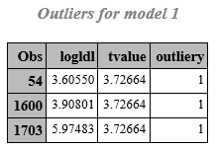
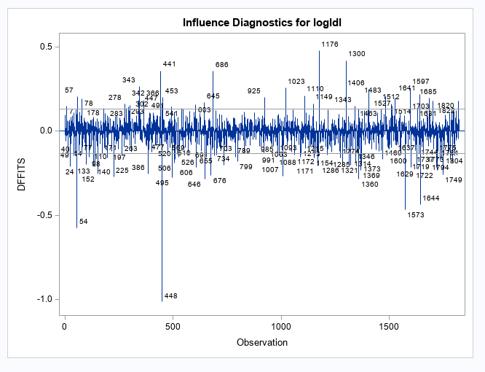
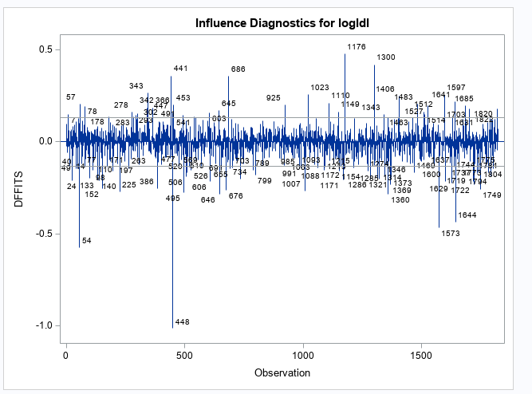
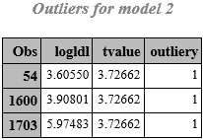
Influential points diagnostics
Model 1 Model 2
Notes:
We performed influential points diagnostics for the 2 best models. As we can see in this slide, both the models have 3 outliers. Bonferroni critical value was used to assess the outliers. This slide also shows the dffits values plots for the selected top 2 models.

Slide 29
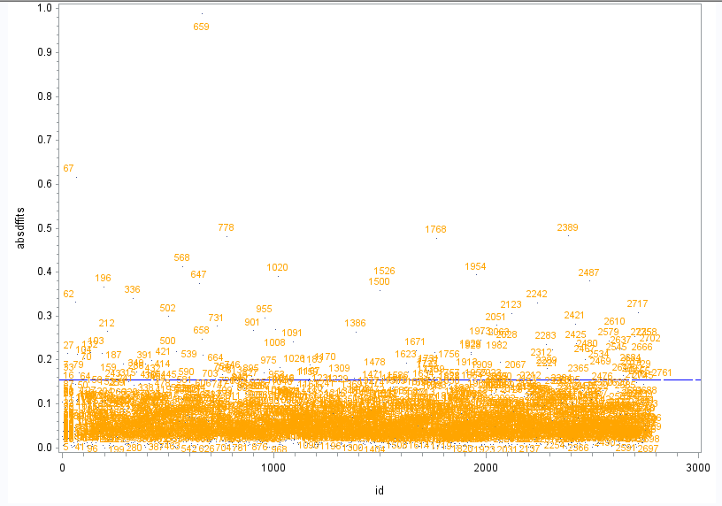
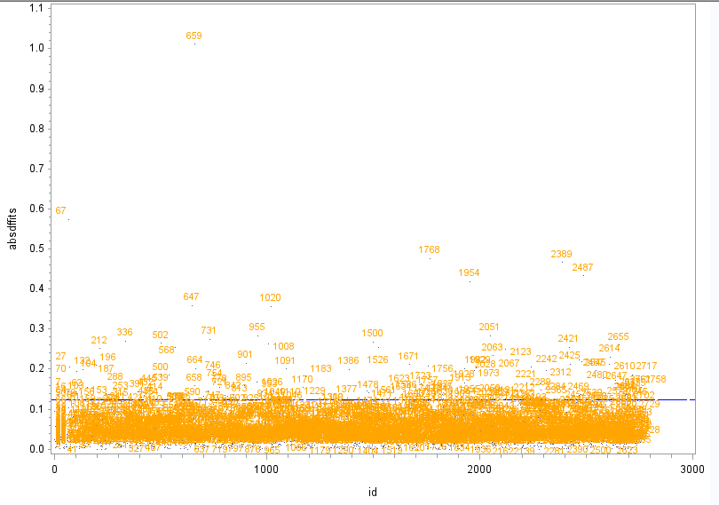
Dffits plots with reference line
Model1 Model2
Notes:
This slide shows plots for the absolute values of dffits with the reference line. Reference line value was calculated using the formula 2√p/n. All the dffits points in the plot that are above the reference line are the influential dffits values.

Slide 30
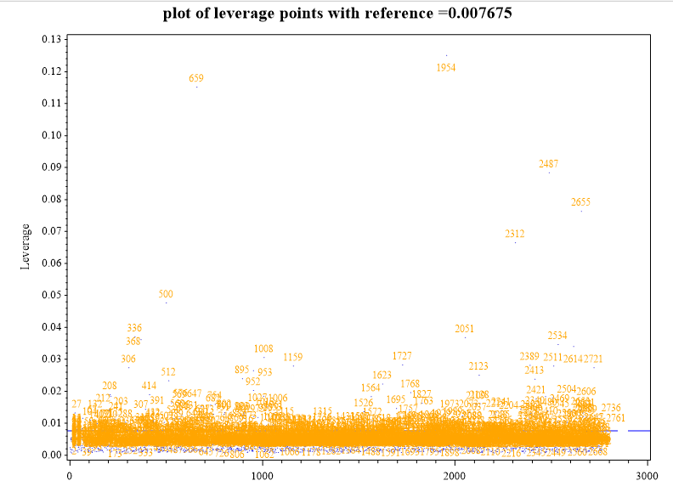
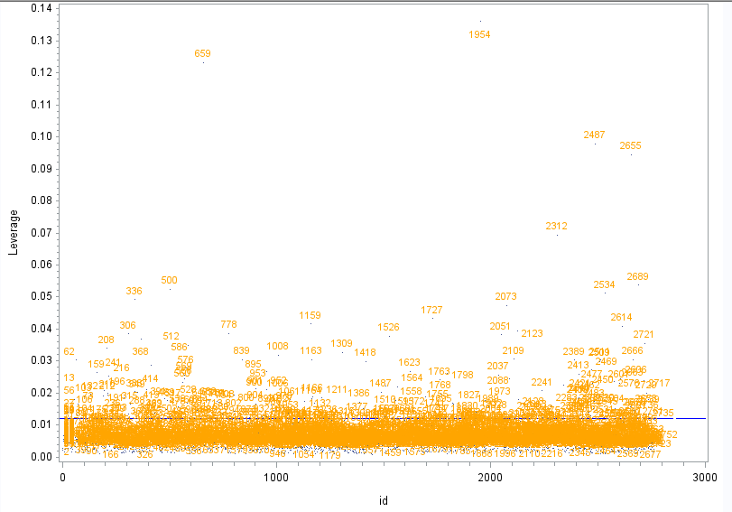
Leverage plots with the reference line
Model1 Model2
Notes:
The plots in these slide show the leverage points. Hatmat values greater than 2p/n were declared as the high leverage points. Around 211 leverage points were identified. We refitted the second model, after removing the leverage points and outliers but didn’t find any big improvement.

Slide 31
Model validation

Slide 32
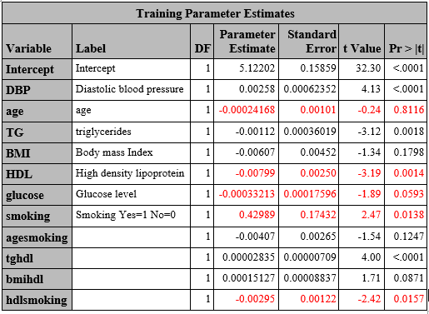
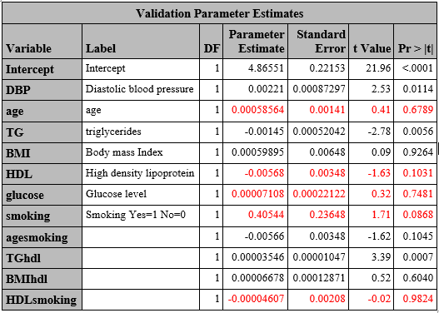
Model validation Model 1
Step1: Comparing coefficients in the two data subsets
Notes:
Model validation was performed for the top 2 models chosen by the Mallow Cp criteria. In step 1, we compared the coefficients for the predictors in the two data subsets. We only focused on the big changes in the parameter estimates and the p-values. The highlighted values in the above tables represent the coefficients that changed their sign from training to the validation set or whose p-values became significant or non significant in the validation set. For model 1, 5 variables (age, HDL, glucose, smoking, and the interaction term of HDL and smoking changed in the validation ses.

Slide 33
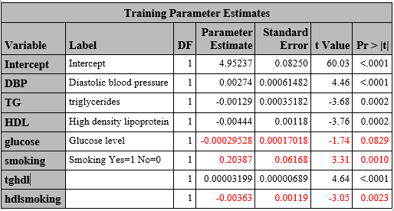
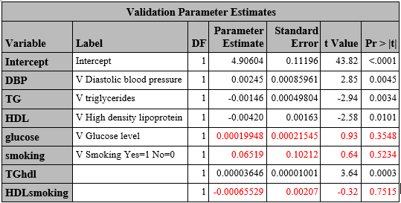
Model validation Model 2
Step1: Comparing coefficients in the two data subsets
Notes:
For model 2, 3 variables: glucose, smoking, and the interaction term of hdl and smoking changed in the validation set.

Slide 34
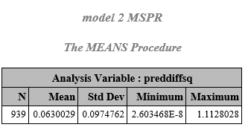
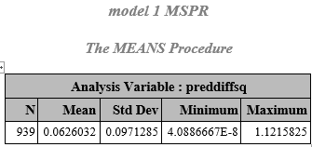
Model validation
Step2: Comparing MSE and MSPR
MSE=0.06506 MSE=0.06521
Difference=0.06506-0.06260= 0.00246 Difference=0.06521-0.06300=0.00221
Adjusted R²=0.0334 Adjusted R²=0.0311
Notes:
In step 2, MSE and MSPR values for the two models were compared. Since, the difference between the MSE and MSPR is lower for model 2 plus it’s a simpler model. Therefore, it was selected as the final model

Slide 35
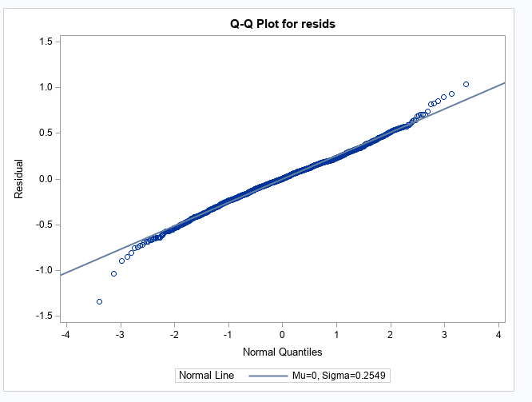
Final Model
Log LDL = 4.95237+0.00274 *Diastolic BP-0.00129*Triglycerides-0.00444*HDL-0.000295*Glucose +0.20387*Smoking + 0.000032*Triglycerides*HDL-0.00363*HDL* Smoking
Adjusted R²=0.0311
MSE=0.06521
Overall significance of F test =<0.001
Notes:
So, this is our final model. As you can see that the log LDL is positively associated with the diastolic BP, smoking, and the interaction term of triglycerides and HDL. Whereas, it is negatively associated with the triglycerides, HDL, glucose, and the interaction term of HDL and smoking. The point worth noting is that the adjusted R² for our final model is very low.

Slide 36
Discussion
Data splitting
Training dataset is randomly selected from raw set and similar distribution show that training set can represents raw data very well
Differences still exist but hard to see.
Model diagnostics
Constancy variance problem not fixed
Normality problem not fixed
May ignore these non-ideal situation in assumptions based on the large sample size
Notes:
Training dataset is randomly selected from raw set and similar distribution show that training set czan represents raw data very well. However, minor differences still exist between the two sets..
We didn’t had any success in fixing the violation of normality and constancy of variance assumptions. However, because of large sample size, we may ignore these violations.

Slide 37
Discussion
Adjusted R square
Adjusted R square is small
Potential predictors do not explain the model very well
Adding behavioral factors may improve the model
Influential points
Data with dropped influential points does not improve the model fitting
Need to look back to the original investigation and explore these influential points
Bootstrap may work well with this data
Notes:
The r^2 for our model is very low which means our model does not explain the variability in the dependent variable very well. Although, we do feel that adding behavioral factors like diet may help in improving the model.
We also found that refitting model after dropping the outliers and the influential points did not lead to much improvement in the model.
One possible explanation for the our model not fitting the data well is the fact that we tried to fit linear data on a non normal data. Theefore, we think that method like bootstrap may work well with this kind of data.

Slide 38
Conclusion
The predictors of LDL include diastolic blood pressure,Triglycerides, High Density Lipoprotein(HDL), Glucose, Smoking.
However, interaction between Triglycerides and HDL, and HDL with Smoking was notable.
Since our final model was validated by splitting the large sample size dataset, we believe that our model is potentially replicable. However, one should remember that no model is perfect.
We recommend future research incorporate other potential predictors of LDL to reevaluate the model.

Slide 39

Thanks

